Slide 1
SRS Immunotherapy Analysis and Results
Chengnan Li

Slide 2
Research Question
Can we use radiomics and machine learning to objectively characterize the differences between patients treated with and without immunotherapy after SRS?

Slide 3
Methods (PREPROCESSING)
Create a spreadsheet (ImmunoReg.xlsx) documenting the T1 Stealth Bravo, T1 Cube Vasc, T2 Flair sequence name in both Pre-SRS and Post-3 month SRS, along with the CT Session
Perform extraction and registration on each patient to get images and masks in one image space (ImmunoExtractionandRegistration.py)
Using the file sequence names, download the pre and post sequences from Flywheel
Then perform registration (Ants.py) on all the image sequences to the Pre-T1StealthBravo sequence
Using the CT session, download the CT and RT Struct files. Extract the RT Struct into NIFTI masks using DicomRTTool.
Fuse the CT and NIFTI masks onto the Pre-T1StealthBravo image space.
Upload all registered images and extracted masks onto Flywheel

Slide 4
Methods (PREPROCESSING)
3. Create batch file that holds the images and masks for each patient (CreateBatchFile.py)
4. Use Pyradiomics to extract radiomic features from all sequences (RunRadiomics.py)
ParamsResample.yaml specify the parameters for running radiomics
Params.yaml normalizes the image and resamples MRI image into isotropic voxel spacing
Extracted radiomic features from each sequence are stored in its corresponding folder

Slide 5
Methods (FIRST Iteration)
Remove all diagnostic data
Remove correlated features using Pearson correlation coefficient
Use Lasso Model for feature selection
Different thresholds for importance values to determine number of features selected (lower threshold, more features)
Selected features used on Lasso, Ridge and Linear SVM Model
Cross-validation technique used was RepeatedStratifiedGroupKFold
Modified from the StratifiedGroupKFold
Ensures that no tumors within the same subject are split across training and validation sets, while also maintaining class balance
The best model was selected based on highest cross-validation AUC score based on the techniques described above

Slide 6
Results (FIrST Iteration)
 | PreT1Bravo | PreT1Vasc | PreT2Flair | Combined
# of tumors | 138 (58 patients) | 128 (52 patients) | 130 (56 patients) | 120 (50 patients)
Test-AUC | 0.7894 ± 0.1318 | 0.8008 ± 0.1578 | 0.6515 ± 0.2115 | 0.8365 ± 0.1558
 | Post3MoT1Bravo | Post3MoT1Vasc | Post3MoT2Flair | Combined
# of tumors | 135 (57 patients) | 132 (53 patients) | 132 (55 patients) | 123 (49 patients)
Test-AUC | 0.6710 ± 0.2007 | 0.7143 ± 0.2026 | 0.7276 ± 0.2006 | 0.7481 ± 0.1995
Observations:
Combining all sequences in both Pre and Post-SRS had better results than individual sequences
Pre-SRS had better performance than Post-SRS

Slide 7
Problems (First Iteration)
Lasso feature selection was performed on entire dataset, leading to leakage into the test set
This was reflected by the fact that the model was giving good test AUC when predicting on random labels
Inference after feature-selection was inherently biased
http://bactra.org/notebooks/post-model-selection-inference.html
If not feature selection, then how do we tackle the curse of dimensionality (p >> n) ?

Slide 8
Methods (SECOND Iteration)
Using nested cross validation to get a more unbiased performance metric
Allows us to do feature selection only on training set, and then evaluate on test set
Trying more complex models:
IsoSVM
MLP
XGBoost
Created Pre vs Post model
Combine Pre and Post data together and try to predict based off features whether the MRI was pre-treatment or post-treatment

Slide 9
Results (Second Iteration)
 | Pre-SRS | Post-SRS | Delta | Pre vs Post
Model | Ridge | SVM | FS + SVM | XGBoost
Train-AUC | 0.9784 | 0.9784 | 0.9760 | 0.9050
CV-AUC | 0.6309 | 0.5348 | 0.6114 | 0.7747
Test-AUC | 0.6530 ± 0.1374 | 0.5154 ± 0.0866 | 0.5535 ± 0.1728 | 0.6987 ± 0.0683
Observations:
Only the Pre vs Post model had decent performance
Large generalization gap

Slide 10
Predicting for Complete Response
 | Delta Radiomics | Pre-SRS | Post-SRS
# of Lesions | 92 | 102 | 105
Best Test AUC | 0.7824 ± 0.1127 | 0.7928 ± 0.117 | 0.7951 ± 0.0851
Train AUC | 1.0 ± 0.0 | 0.963 ± 0.0081 | 0.8601 ± 0.0182
Model | XGBoost | Random Forest | Ridge
Observations:
Delta Radiomics and Post model performed really well, which was to be expected
Pre-SRS had a high AUC, indicative that the pre-treatment MRI could predict for complete response
When looking into some of the features (as in the next 3 slides), it showed that lesions that were more homogeneous, had lower intensities, and smaller volume were more likely to have CR

Slide 11
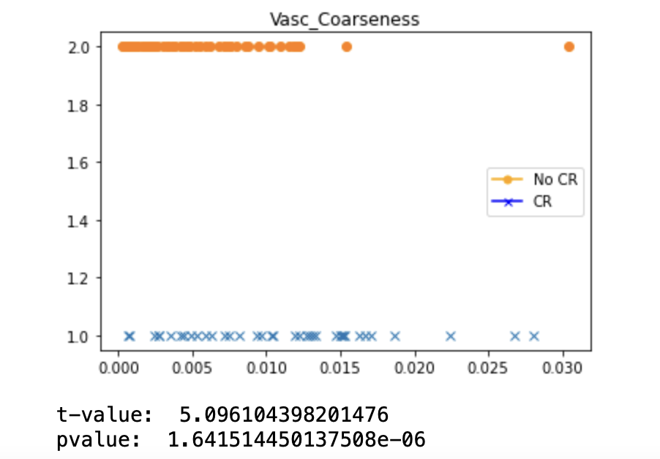
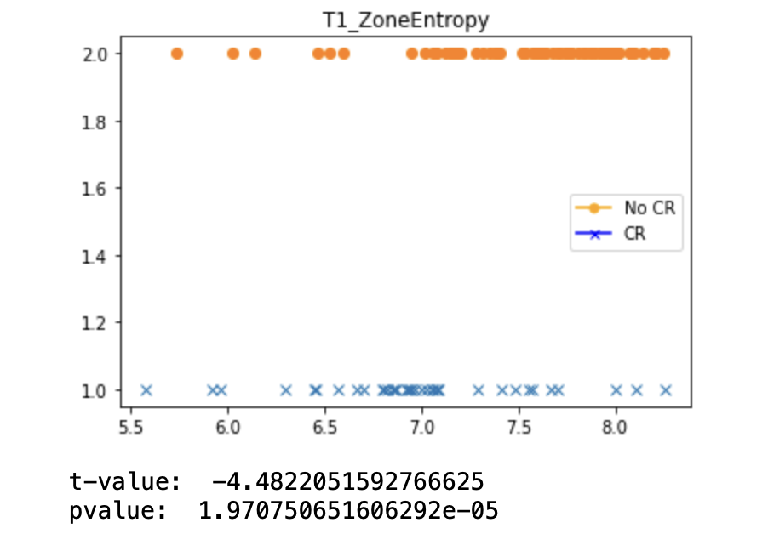
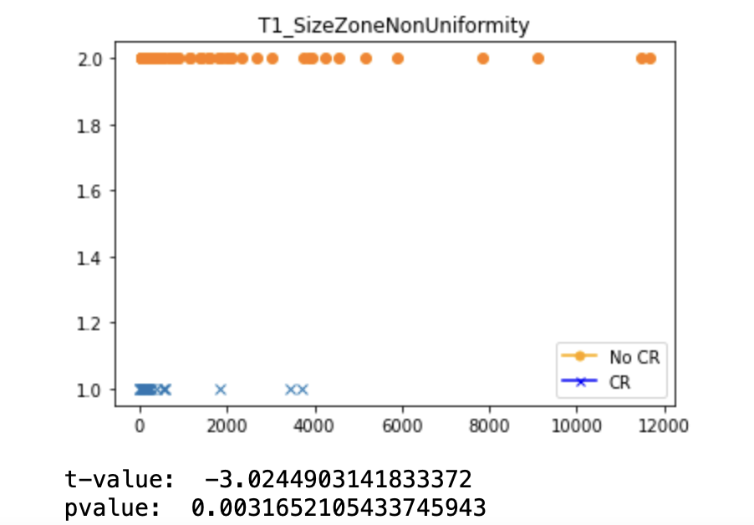
Texture Features (Pre-SRS)
Higher value indicates a lower spatial change rate and a locally more uniform texture
Higher value indicates more heterogeneity in texture patterns
Lower value indicating more homogeneity in size zone volumes

Slide 12
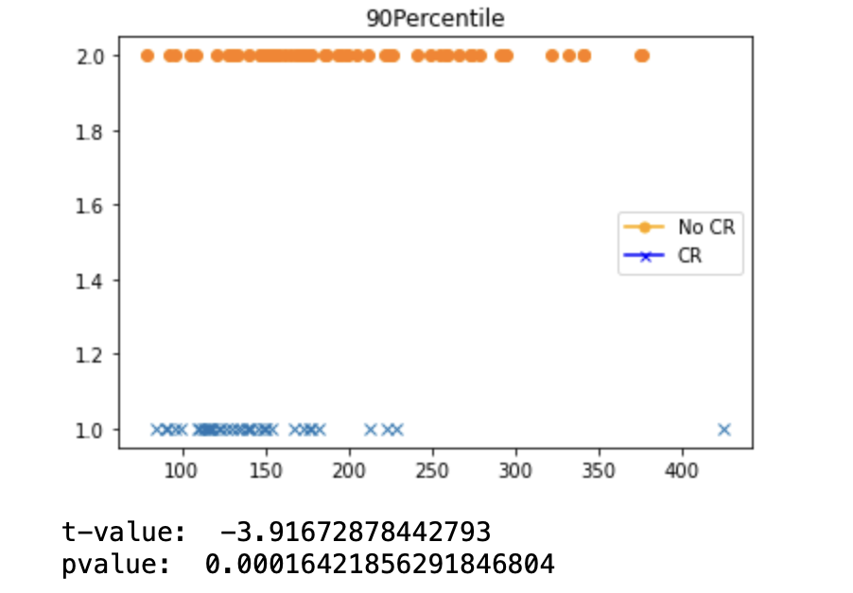
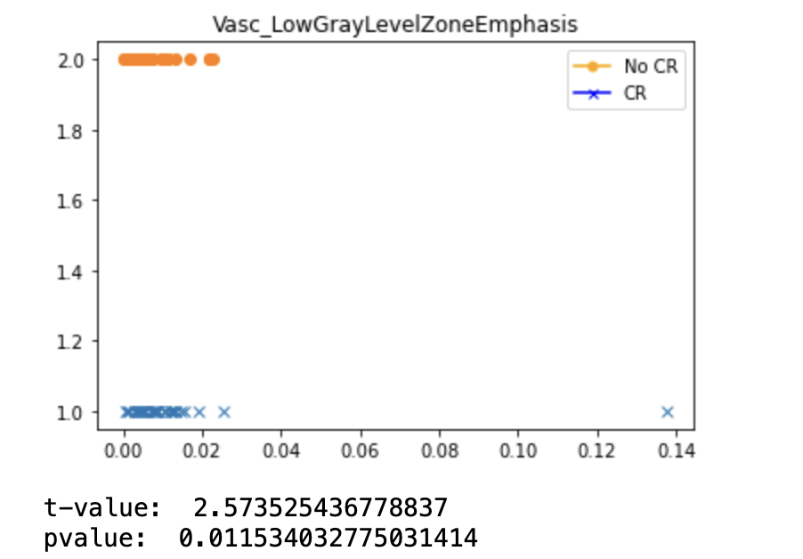
First order Features
Higher value indicates a greater proportion of lower gray-level values and size zones in the image

Slide 13
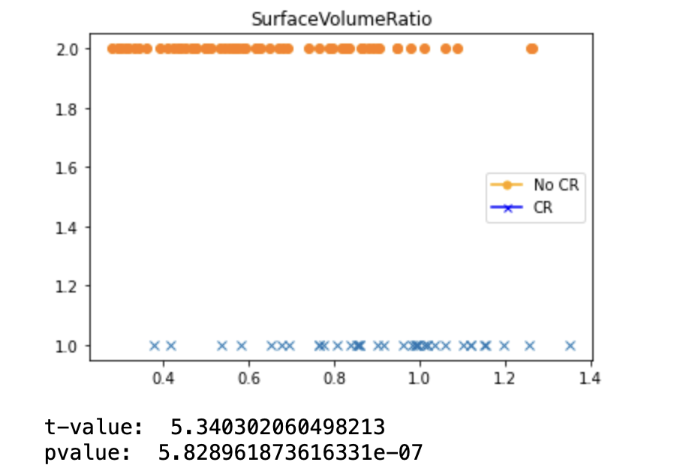
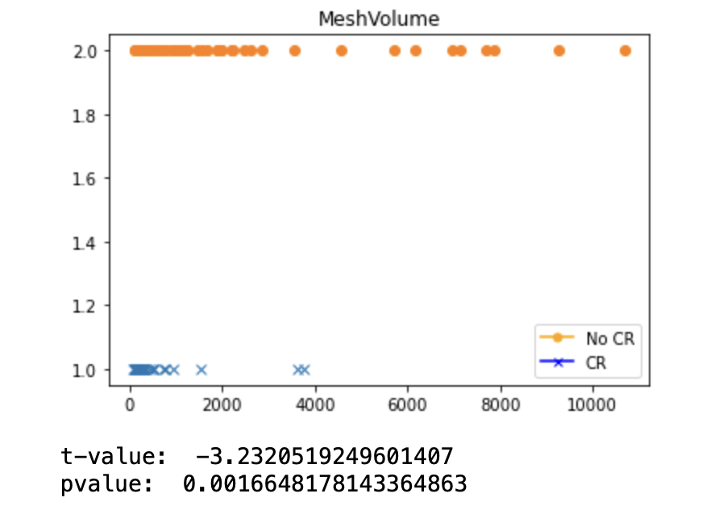
Shape Features
Lower value indicates a more compact (sphere-like) shape.
Volume of ROI calculated from triangle mesh of the ROI

Slide 14
PROBLEMS
Smaller lesions respond no matter what, so it is more clinically interesting to examine the bigger lesions
When filtering out smaller lesions, the performance dropped by about ~0.1 AUC
Might be due to a decrease in data set size
Large class imbalance between CR and no CR
Is using SMOTE the best way to address that imbalance?

